Slide 1

Technology in music industry
The past, the present and the future

Slide 2
Agenda
Music production
Hardware & software
New technologies
AI music production
Music consumption
Streaming vs. buying music
Recommendation systems on Spotify
Communities

Slide 3
hardware
Synthesizers
Electric instruments
Samplers
DJ consoles

Slide 4
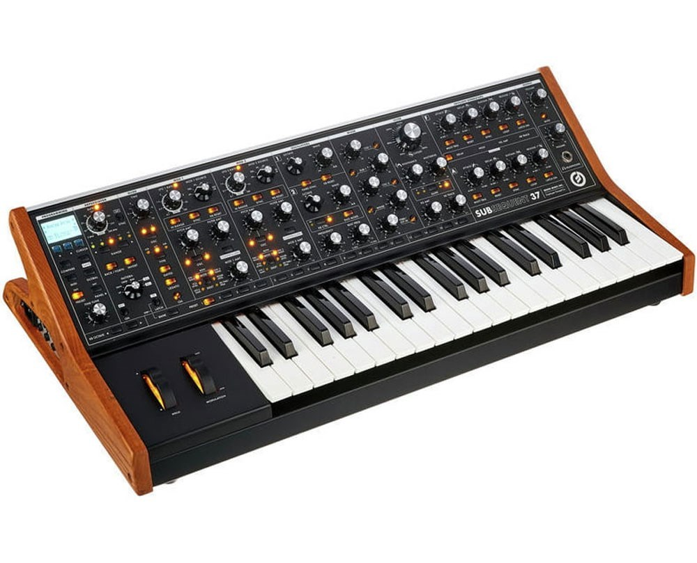
Synthesizers

Slide 5
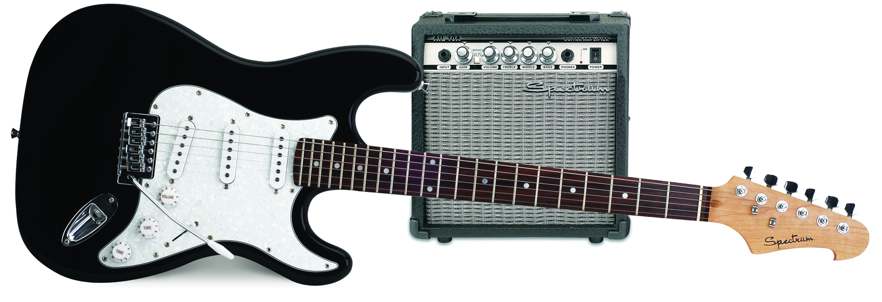
Electric instruments

Slide 6
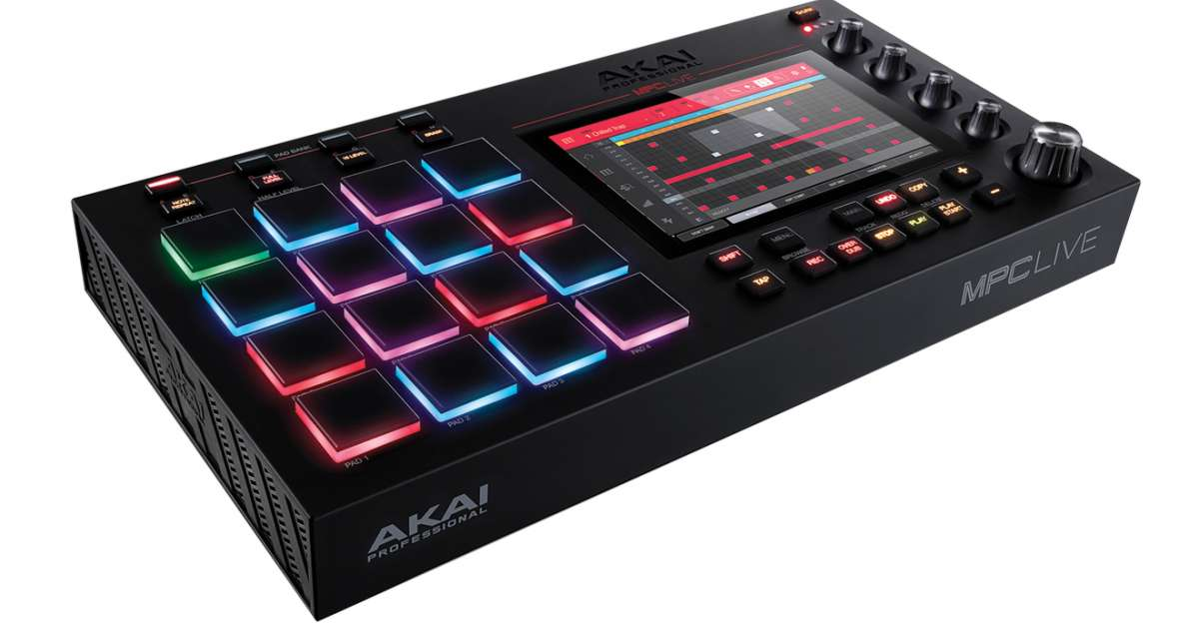
Samplers

Slide 7
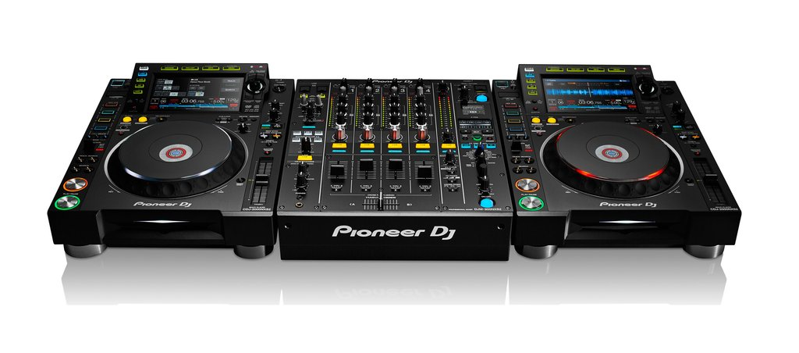
DJ Consoles

Slide 8



software

Slide 9
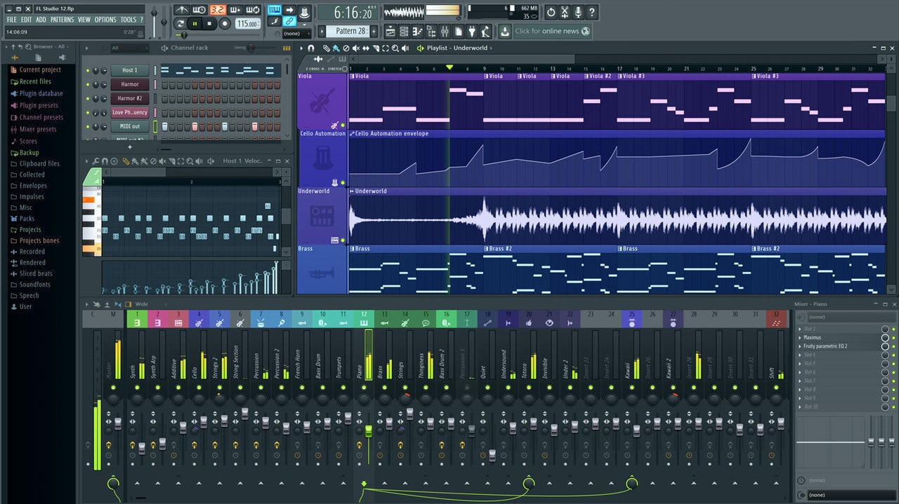
FL studio User interface

Slide 10
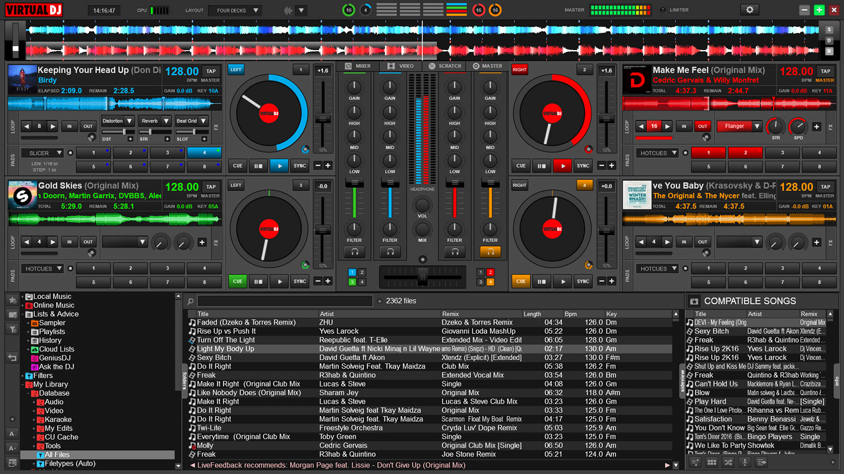
Virtualdj user interface

Slide 11
New technologies
Project Magenta
Google NSynth Super
Amper AI
AIVA

Slide 12

Project Magenta

Slide 13
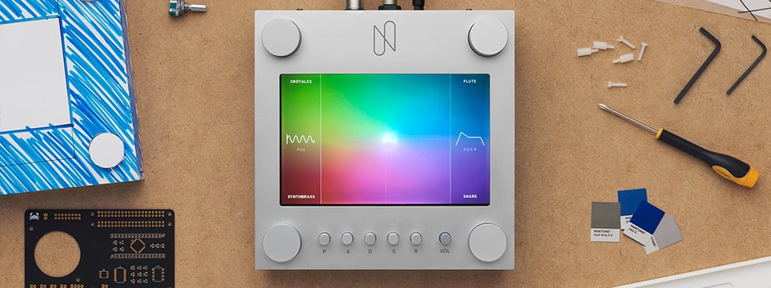
Google Nsynth Super
https://www.youtube.com/watch?v=0fjopD87pyw

Slide 14

Amper AI
https://www.youtube.com/watch?v=XUs6CznN8pw
Notes:
https://www.youtube.com/watch?v=XUs6CznN8pw

Slide 15

AIVA
https://www.youtube.com/watch?v=HAfLCTRuh7U
Notes:
Artificial Intelligence Virtual Artist
https://www.youtube.com/watch?v=HAfLCTRuh7U

Slide 16




Streaming vs. Buying

Slide 17


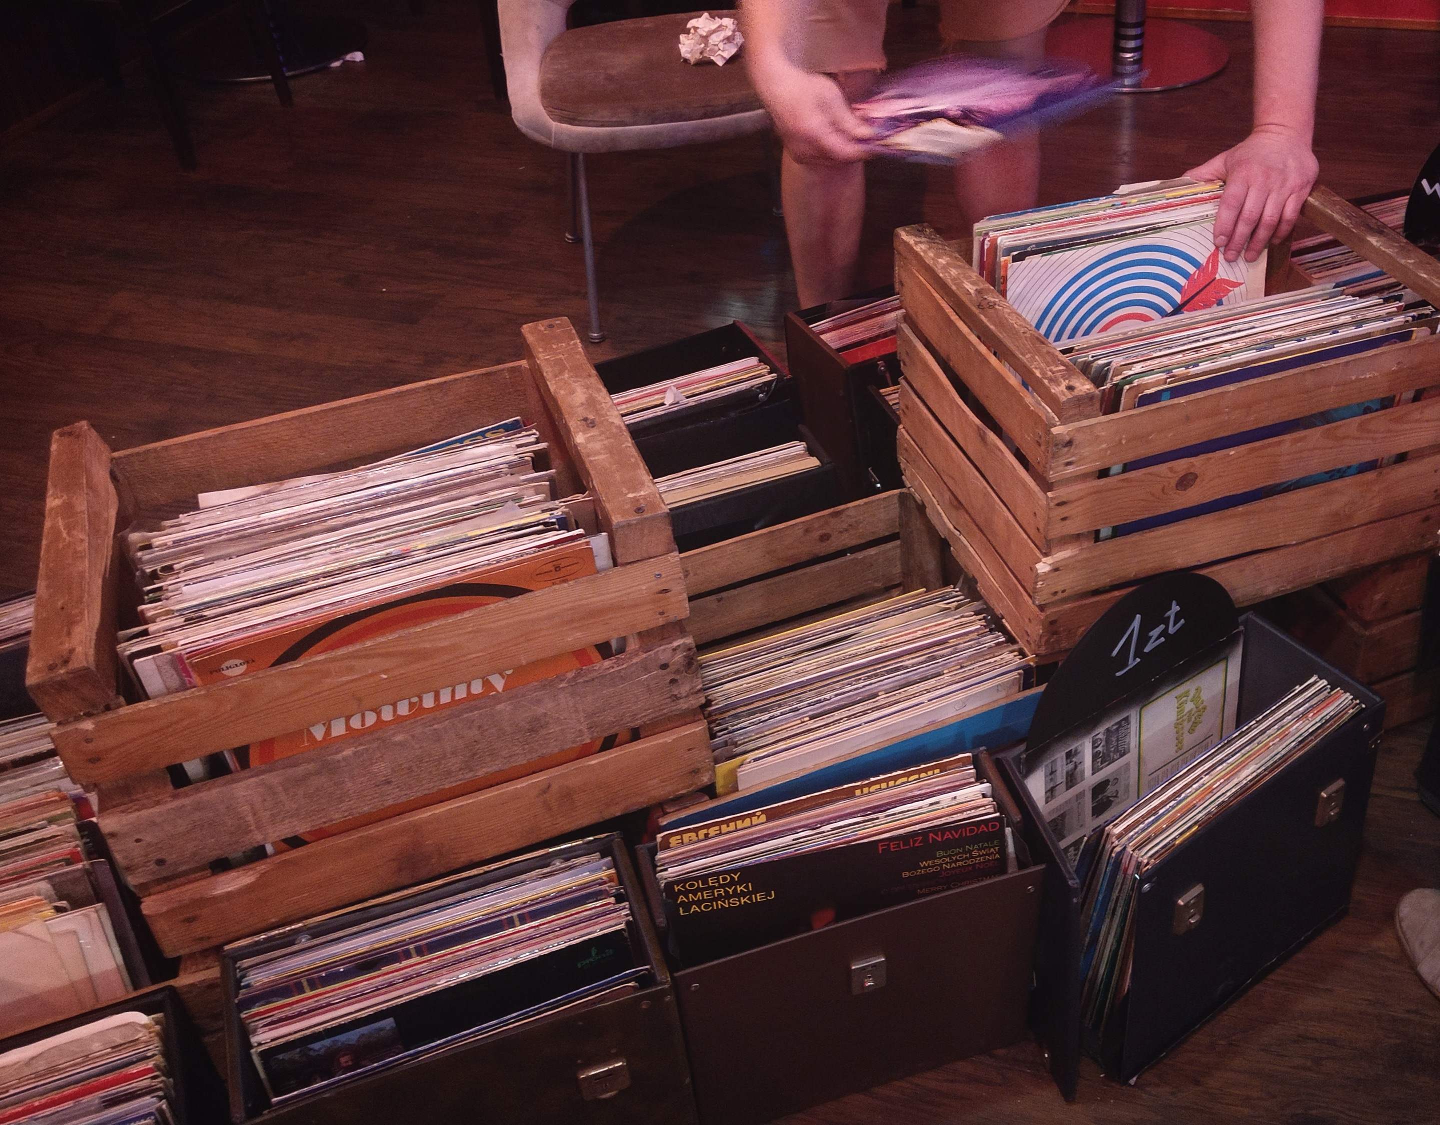


Streaming services & online music shops

Slide 18
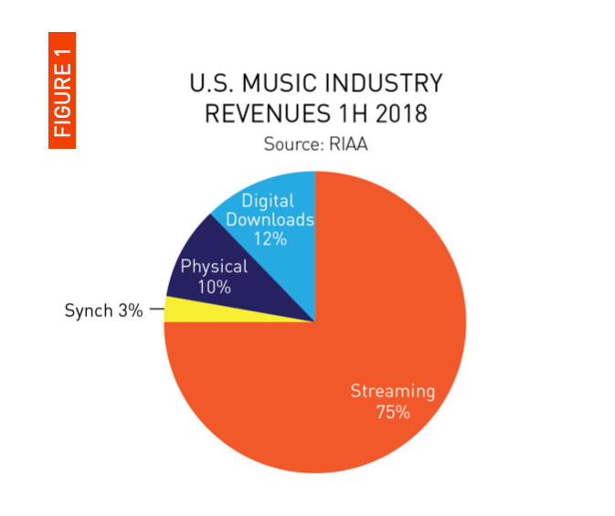
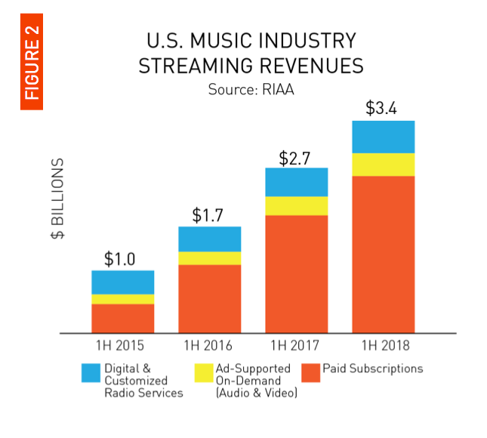
Streaming growth

Slide 19
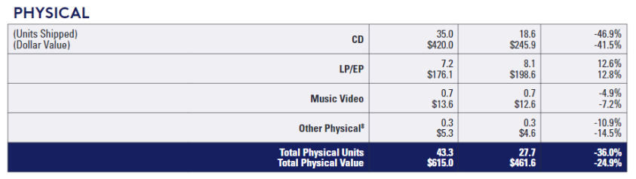
Fun fact: vinyl growth

Slide 20
Recommendation systems on spotify
Brief history
Collaborative Filtering
Natural Language Processing
Audio models

Slide 21




Recommendation systems
Songza – manual curation (2000s)
Pandora – manually tagging atributes (2000s)
The Echo Nest – algorithm to analyze the audio and textual content (2000s)
Last.FM – collaborative filtering

Slide 22
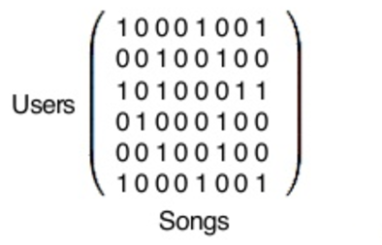
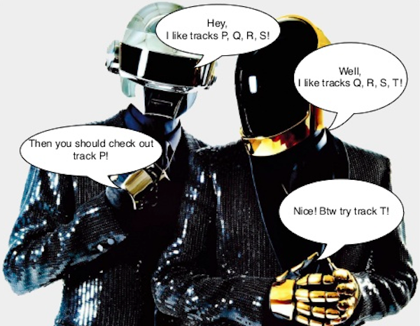
Collaborative filtering

Slide 23
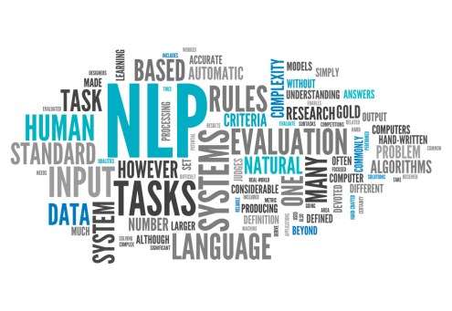
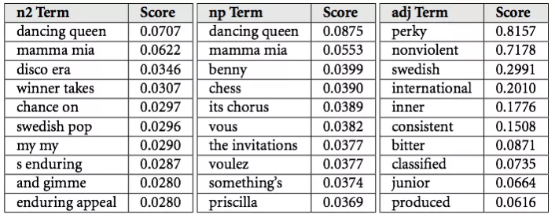
Natural language processing (nlp)

Slide 24
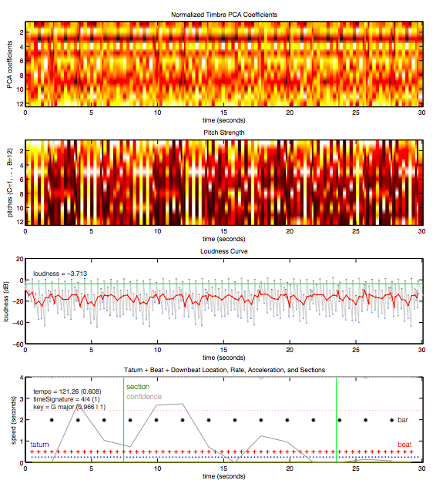

Raw audio models

Slide 25



Social networks

Slide 26
Bibliography
https://nsynthsuper.withgoogle.com/
https://futurism.com/the-worlds-first-album-composed-and-produced-by-an-ai-has-been-unveiled
https://www.ampermusic.com/
https://www.aiva.ai/
https://futurism.com/a-new-ai-can-write-music-as-well-as-a-human-composer/
https://www.theverge.com/2018/9/20/17883584/streaming-record-sales-music-industry-revenue
https://www.theverge.com/2018/3/22/17152120/digital-downloads-cd-vinyl-riaa-2017-report
https://medium.com/s/story/spotifys-discover-weekly-how-machine-learning-finds-your-new-music-19a41ab76efe

Slide 27
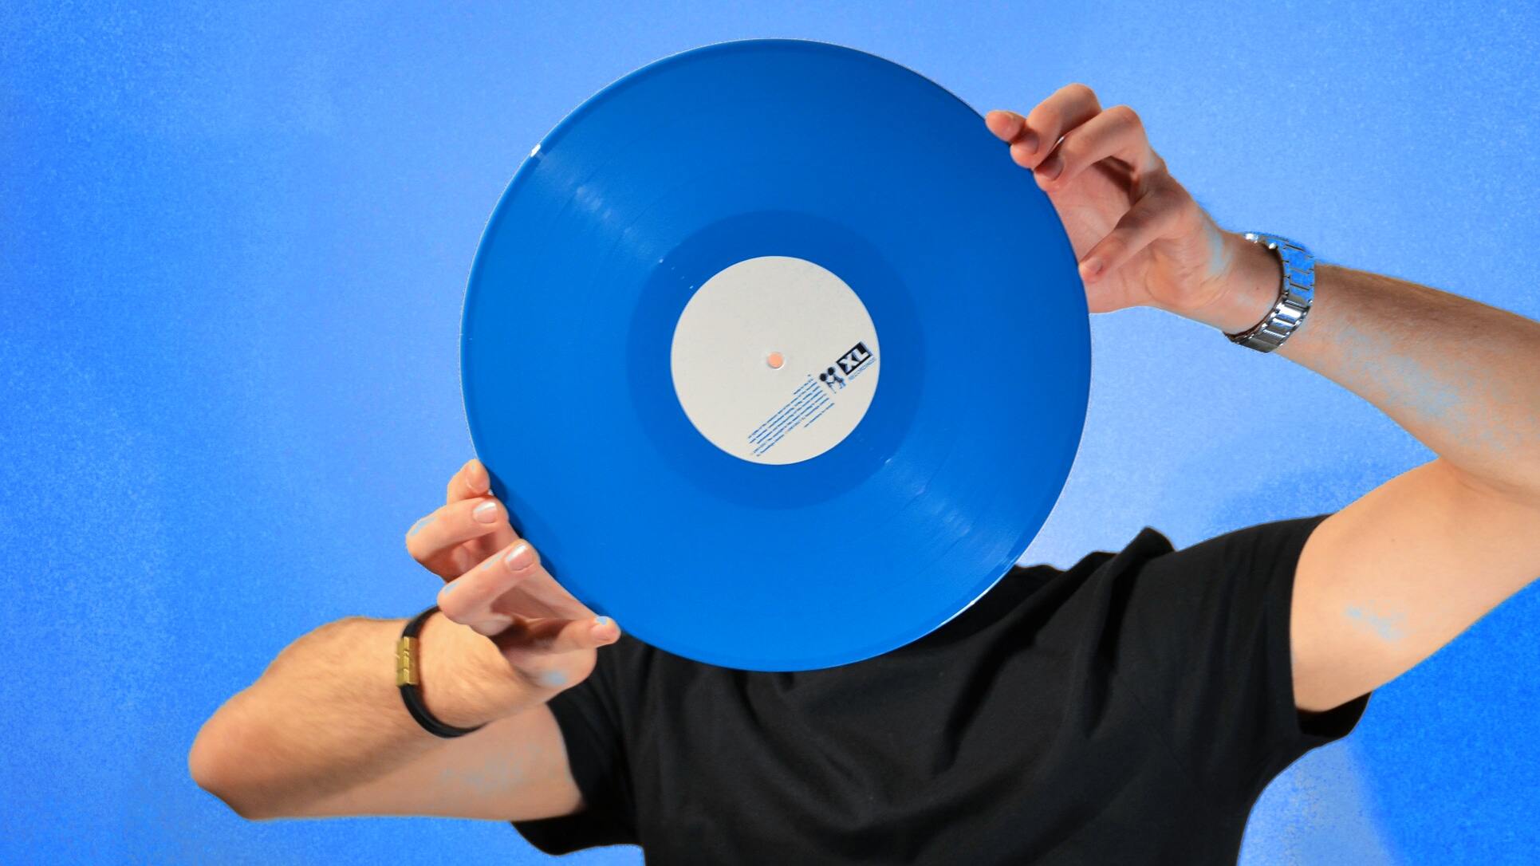
Thank you for attention!

